Slide 1
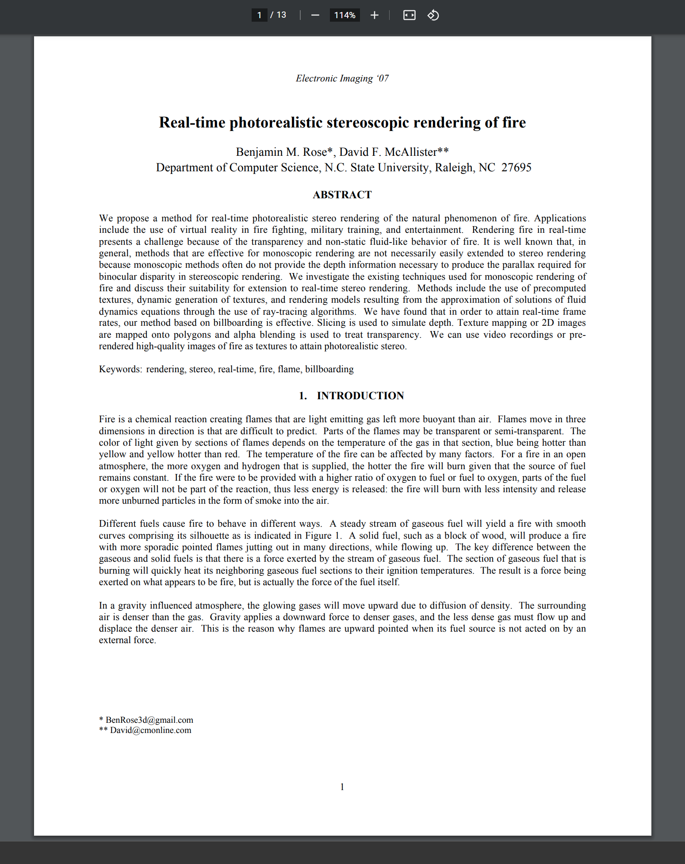

Real-Time Photorealistic Stereoscopic Rendering of Fire
Benjamin M. Rose and David F. McAllister
2007 Conference: Stereoscopic Displays and Virtual Reality Systems XIV
DOI : 10.1109/cad/graphics.2011.26

Slide 2
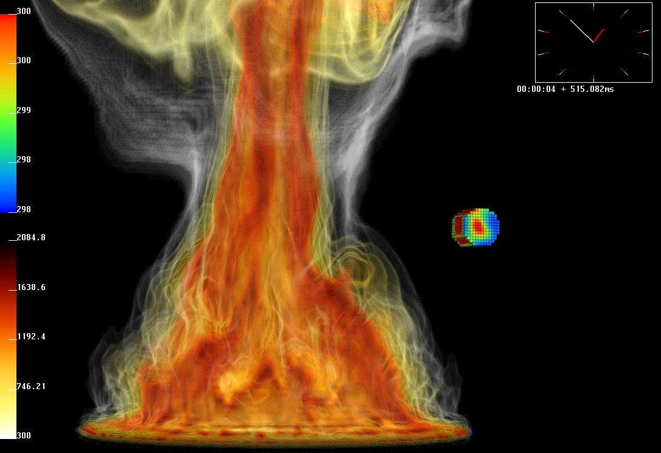
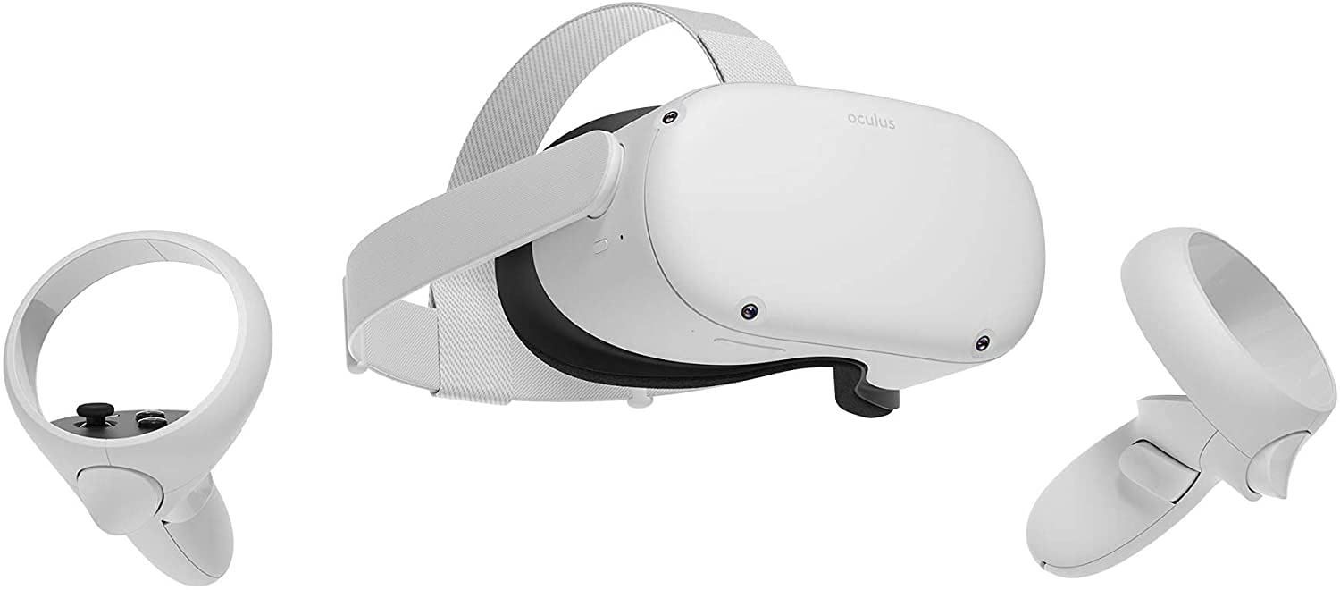
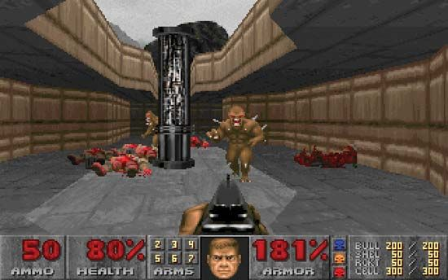
Motivation
Rendering of realistic fire using particle systems and complex Navier-Stokes equations is often too computationally expensive for real time and interactive VR applications.
The solution this paper proposes can be applied to many other scenarios which improve the optimization of scene rendering.
Learn to replicate the style of retro video games.

Slide 3
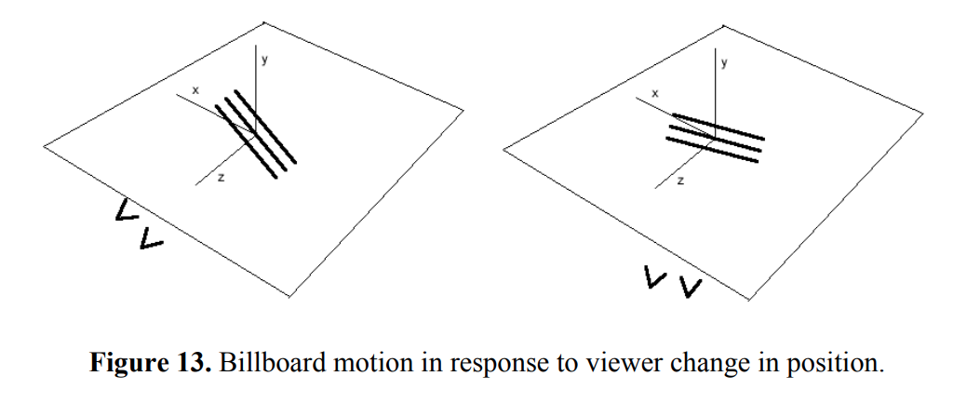
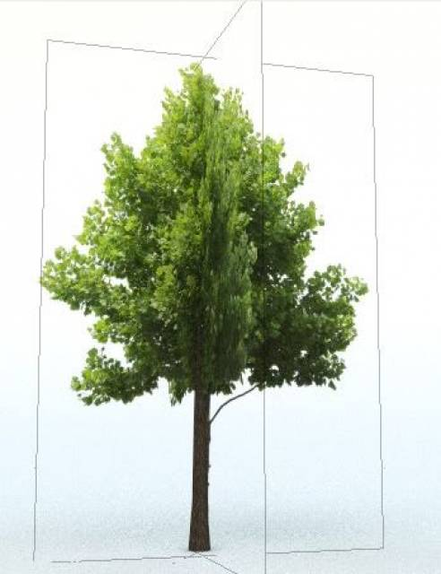
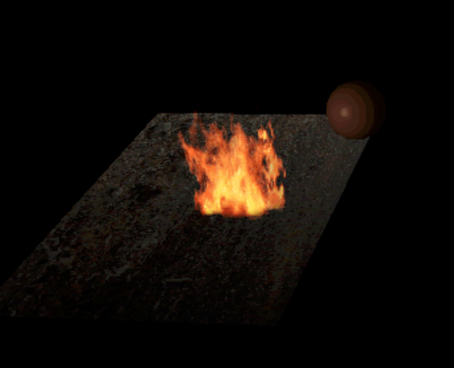
Billboarding
Technique used to improve the performance of rendering objects in a scene
Uses 2D Images or sprites that always face the camera to create the illusion of a 3D object.
Challenges worth Exploring
Viewpoint Restrictions
Modification Restrictions
Alpha Blending
Lighting Restrictions

